Slide 1

4900 Project Slide
Overview of the automation process

Slide 2
Objective/Goal
Through this project I want to demonstrate not just what I have learnt through working at my job but the industry standards that are being used in the real world for anyone who would become a QA. Manual testing has dominated the industry for a while until automation became a useable factor with the availability of open-source libraries and tools which helped increase the testing capabilities to lower the issues within apps and websites (bugs, defects, etc.) while also ensuring they are more useable, functioning, and users/business owners are delivered a working product.

Slide 3
Somethings to keep in mind….
This project is done solely by me whereas in a company we have multiple projects working on different aspects of the website/app and require a lot more time and effort to flesh out. Each project has many members to work on these features, fixes, etc. so I will be demonstrating the QA aspect whereas my work would involve developers for bug fixes, project manager(s) to make sure progress is constantly on track, product/business owners who constantly keep us in loop if things change in the project etc.
I will try to demonstrate these other aspects to the best of my ability to imitate how a team would function day-to-day.

Slide 4
Project Board
Project Board: https://github.com/users/rahmann00dles/projects/1
Companies use many different variations of project boards (Jira, GitHub, Kanban, etc.)
With the use of the project board I will demonstrate how we report bugs, new features that need coding, our process of reviewing each others work and the day-to-day flow at work.
The usual flow we follow is:
Dev creates and pushes code
Project Manager reviews QA and Dev work
QA reviews code
Does Code Pass?
Yes
Does everything match plan?
No
Yes
Does business/product owner agree?
Merge code and demo to product/business owner
Close out ticket and move to next task
Yes

Slide 5
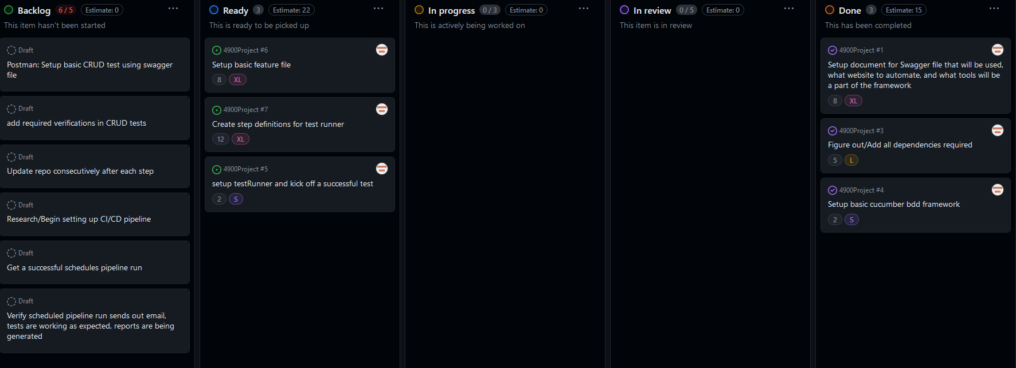
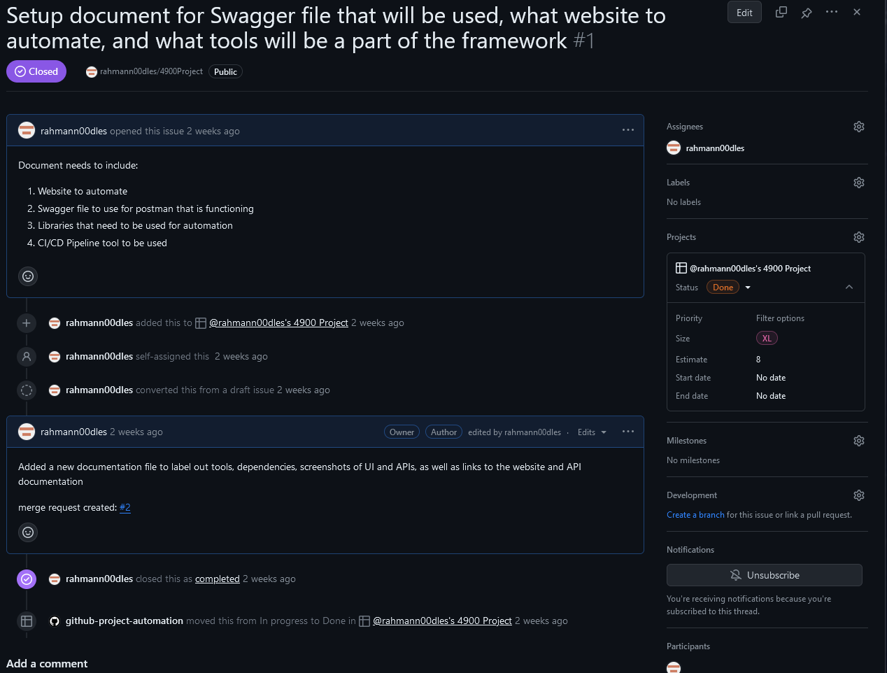
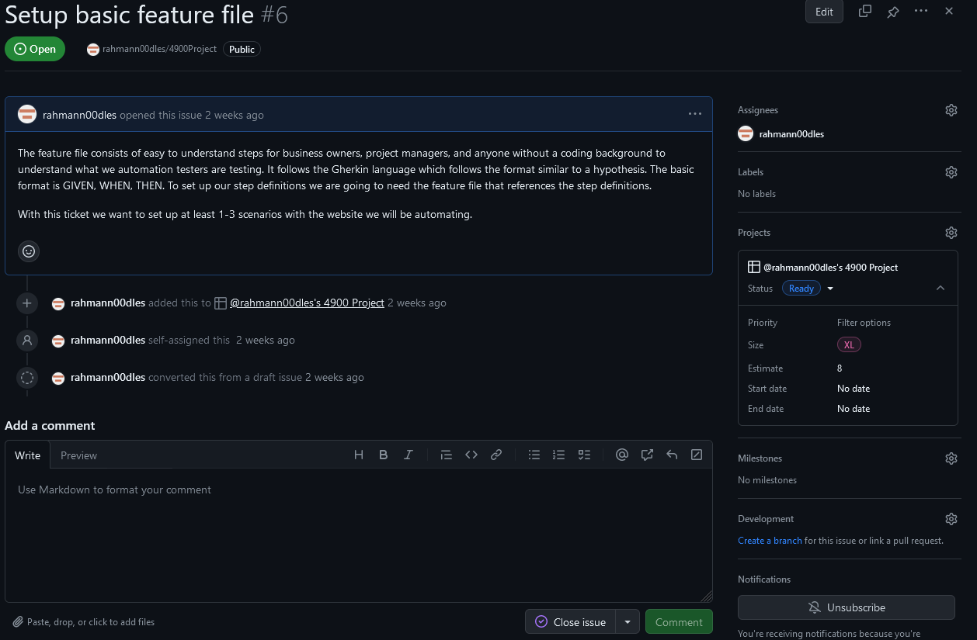
Project Board Setup:
Project Board
Task that needs completing
Completed Task

Slide 6
Cucumber
Cucumber is a tool we QAs specifically use to help business/product owners to understand what it is we are testing, verifying, or ensuring is constantly functioning since new code/features are always being added to the website/app.
This style of testing is known as Behavior Driven Development (BDD). This, in essence, means we are testing the behavior of the website/app and developing scenarios that are easy to understand, and clearly show what is expected of the website/app.
This is done using a specific language made for cucumber and these feature files called: Gherkin
Gherkin is easy to understand, clear, concise, and follows a Given, When, Then
This is for anyone who can’t understand the code behind each step so that they have an idea of what is happening even if the code isn’t understandable or is too complicated to understand.

Slide 7
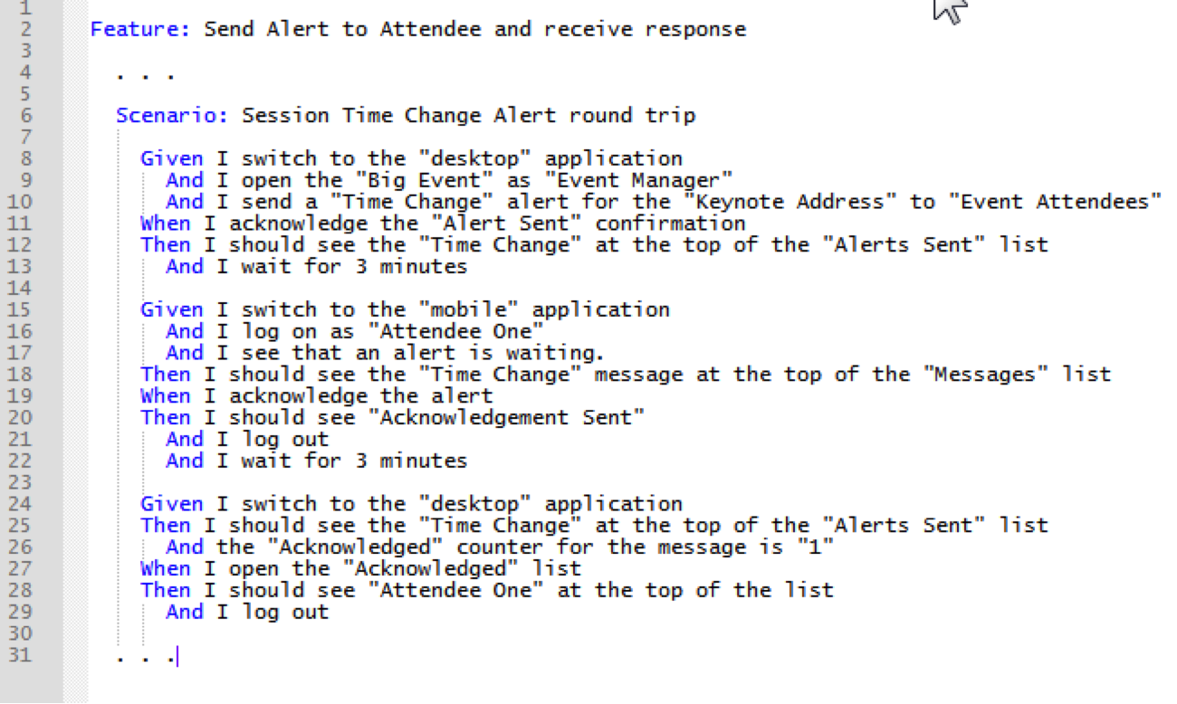
Feature File Example

